Slide 1
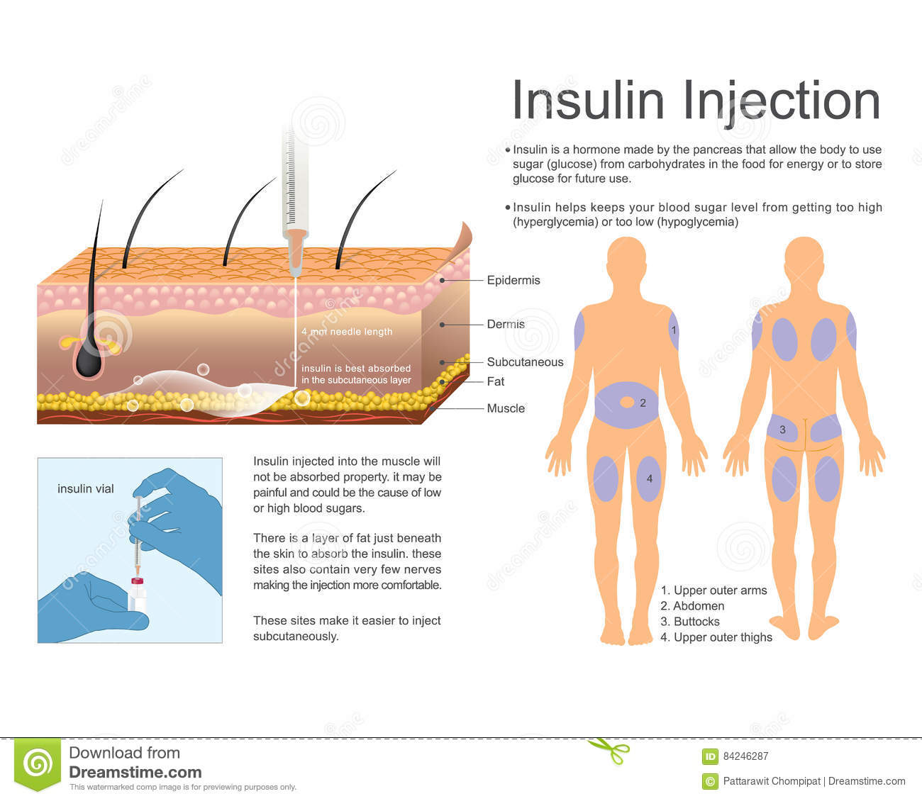
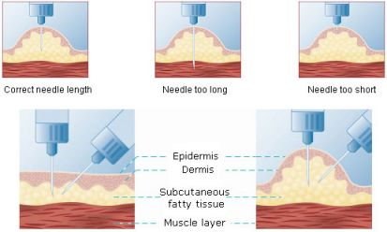
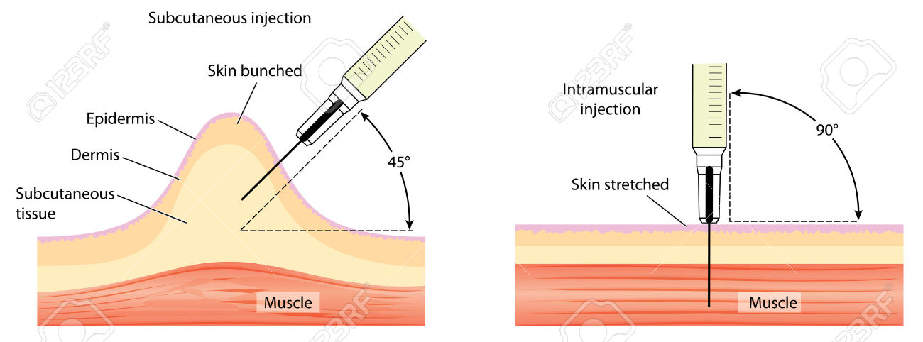
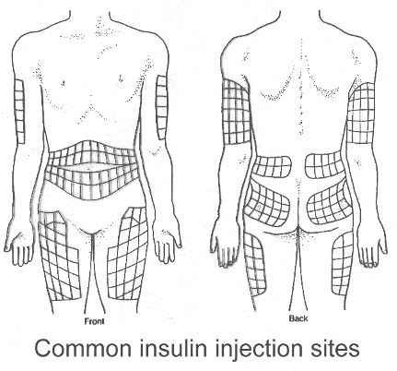
Generally, there is not a need to pinch the skin if using a needle < 6mm in length, unless very lean.
1.Frid AH, Kreugel G, Grassi G, et al. New insulin delivery recommendations. Mayo Clin Proc.2016;91(9):1231–1255.

