Slide 1
M in the Box
M
Notes:
Flown 150 flights this year
Countless hours of meetings, conferences, site visits.
SG has 16 learning years every year (50 coaches x 120 days = 6,000 days/year=16y)
Coolest thing I learned this year requires a marker. (get as prop)
The 400 who attend our HCAHPS Summit already know (and many are already doing) this practice.
Don’t wait for the evidence.

Slide 2
Simple Tactic, Profound Results
Safety: Engage patient in monitoring for side effects/reactions; Opportunity for “teach-back”
Patient engagement: verbal and visual, two-way communication with patient about all new medications and any possible side effects
HCAHPS: Hardwire explanation of medication and side effects
Decreases patient’s anxiety
Caregiver efficiency

Slide 3
It’s not what we do for patients.
It’s what we do with patients.

Slide 4
This era is ending, being replaced with consumerism and the movement toward shared decision making.
–Teutsch, C. Patient–doctor communication. The Medical Clinics of North America 2003;87:11-15-45.
Previous research has demonstrated a strong relationship between patient-centered patterns of communication and higher levels of satisfaction and trust.
–Jackson JL. Communication about symptoms in primary care: impact on patient outcomes. The Journal of Alternative and Complementary Medicine 2005;11(Supplement 1):S-51–S-56.

Slide 5
M in the Box
Enhancement to Bedside Shift Report
Engage patient, improve safety & HCAHPS
explanations of medications
understanding of side effects
Technical Requirements:
Board
Marker
Ability to draw a square and write letter “M”
30 seconds

Slide 6
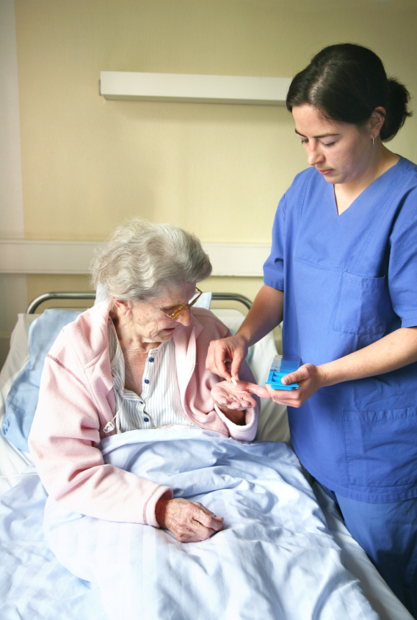
Step 1:
If a new med ordered during the shift, the nurse will explain the medication and possible side effects to the patient.
Then, puts the letter “M” in the box drawn on the board.
Add name of medication next to “M”
“Mrs. Smith, I’m writing the M in the box to remind both of us that you had a new medication and I have communicated to you the reason for the medication and any possible side effects.”

Slide 7
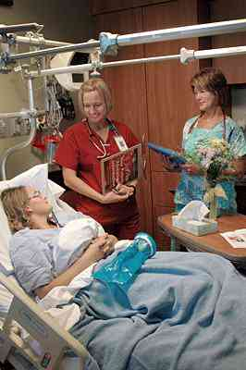
Step 2:
Later, during bedside shift report, the off- going nurse points out the “M in the Box”
“Dr. Jones ordered Mrs. Smith a new medication”.
“Mrs. Smith, do you remember the name of the new medication?
Can you tell me why Dr. Jones ordered it for you?
Can you also tell me one of the side effects of the medication?”

Slide 8
Step 3:
The off-going nurse checks back with the on-coming nurse
The process continues each shift until the patient is released. If no new medication is ordered the box should be empty.
“As you heard, Mrs. Smith is aware of her new medication and possible side effects.”
“I will erase the “M in the box”, so that you can fill it in if another new medication is ordered for Mrs. Smith during your shift.”

